Slide 1
PYTHON

Slide 2
LEARNING OBJECTIVES
At the end of this lesson, you should be able to
List the important data types supported by Python
Discuss data structures, such as lists, tuples, sets, and dicts
Explain slicing and accessing the four data structures
Discuss basic operators and functions
Outline the important control flow statement

Slide 3
Anaconda: The World's Most Popular Data Science Platform
The following are some of the reasons why Anaconda is one of the best Data Science platforms:
Open source Python distribution
Enterprise-ready Data Analytics platform
Modern Data Science analytics architecture
Multi-workload Data Analytics
400+ popular Python packages
Interactive visualizations, governance, security, and operational support

Slide 4
Installation of Anaconda Python Distribution
You can install and run the Anaconda Python distribution on windows as follows
Website URL:
https://www.continuum.io/downloads
Graphical Installer
• Download the graphical installer.
• Double-click the .exe file to install Anaconda and follow the instructions on the screen

Slide 5
Jupyter Notebook
Jupyter is an open source and interactive web-based Python interface for Data Science and scientific computing.
Some of the advantages are
Python language support
Big Data platform integration
Content sharing and contribution
Built-in interactive widgets

Slide 6
Reserved words
if | print | for | while | input | is
break | False | True | class | return | None
and | as | try | assert | break | except
yield | in | import | pass | with | continue
finally | global | from | lambda | not | import

Slide 7

Variables and Assignment
A variable can be assigned or bound to any value. Some of the characteristics of binding a variable in Python are listed here:
The variable refers to the memory location of the assigned value.

Slide 8
Multiple Assignments
You can access a variable only if it is defined. You can define multiple variables simultaneously.

Slide 9
Assignment and Reference
When a variable is assigned a value, it refers to the value’s memory location or address. It does not equal the value itself.

Slide 10
Operator | Operations
+ | Addition
_ | Subtraction
/ | Division
* | Multiplication
** | Power
% | Remainder

Slide 11
Operator precedence rule
Highest precedence rule to lowest precedence rule
Paranthesis
Exponentiation
Multiplication, Division and Remainder
Addition and Subtraction
Left to right

Slide 12
Example: 1 + 2 ** 3 / 4 * 5

Slide 13
A tuple is a one-dimensional, immutable ordered sequence of items which can be of mixed data types

Slide 14
Slicing tuples
You can also slice a range of elements by specifying the start and end indices of the desired range

Slide 15
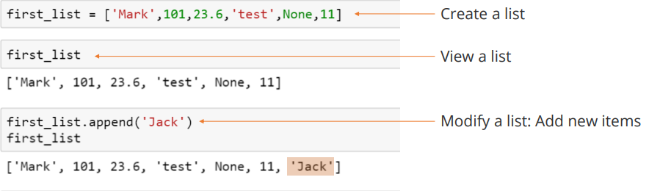
LIST
A list is a one-dimensional, mutable ordered sequence of items which can be of mixed data types.

Slide 16
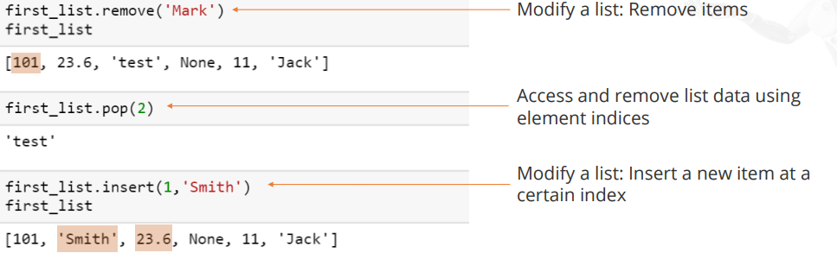

Slide 17
Slicing in list is similar to that of tuples

Slide 18
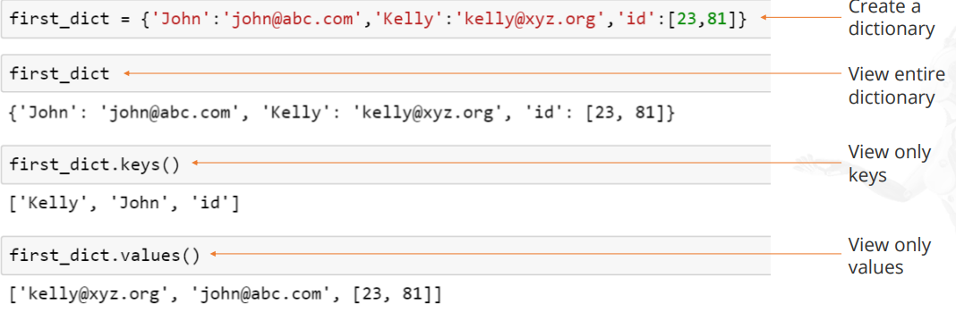
DICTIONARY
Dictionaries store a mapping between a set of keys and a set of values
You can view the keys and values in a dict, either separately or together, using the syntax shown here.

Slide 19
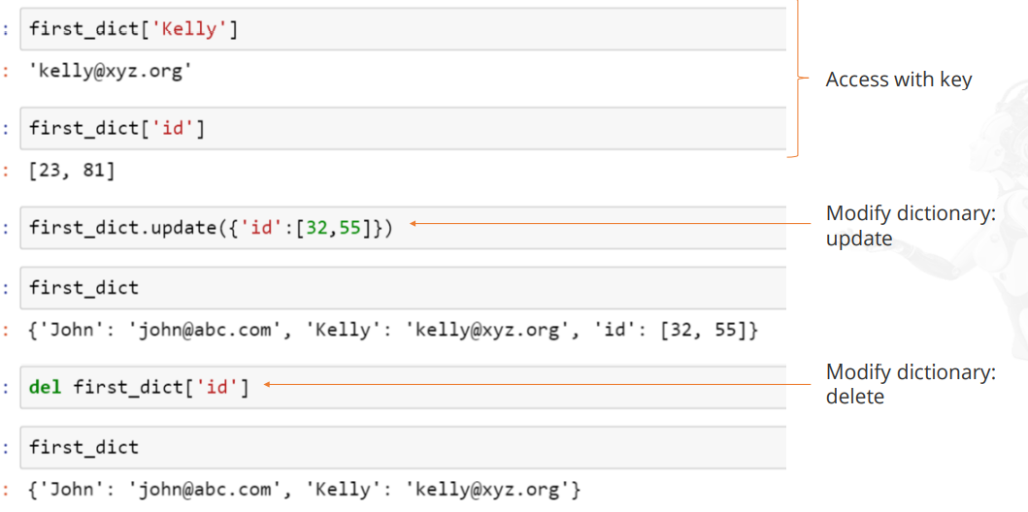
You can also access and modify individual elements in a dict.

Slide 20
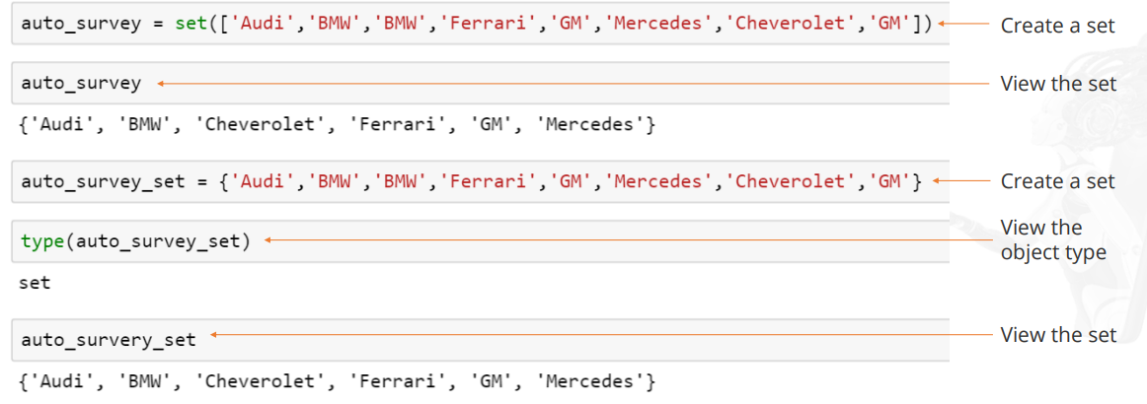
SET
A set is an unordered collection of unique elements

Slide 21
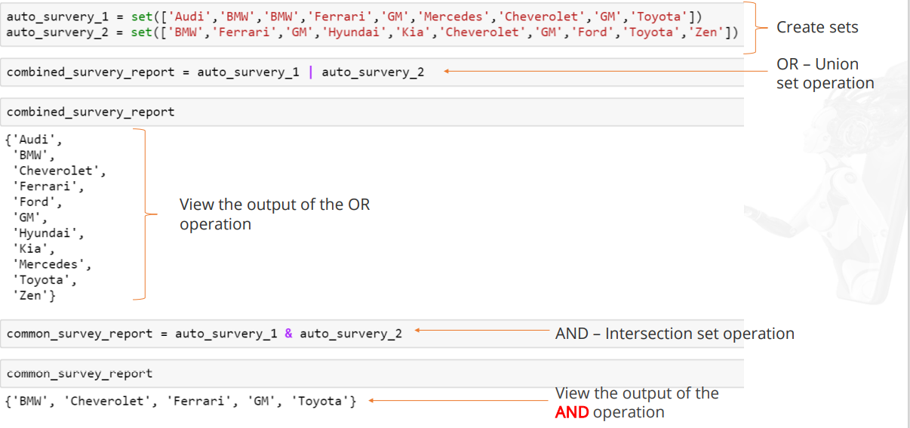
DATA STRUCTURE : SET OPERATIONS

Slide 22
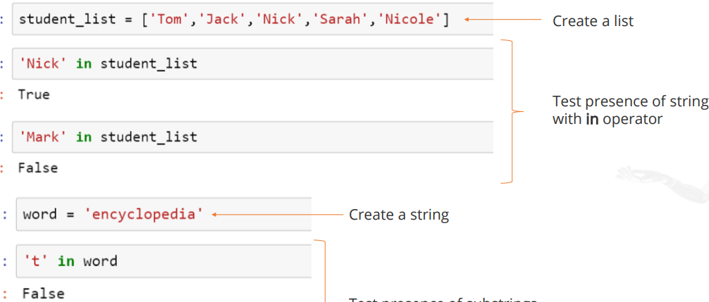
BASIC OPERATOR : IN
The in operator is used to generate a Boolean value to indicate whether a given value is present in the container or not.

Slide 23
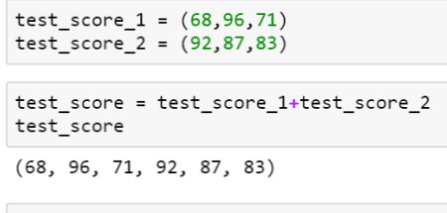
Basic Operator: +
The plus operator produces a new tuple, list, or string whose value is the concatenation of its arguments.

Slide 24
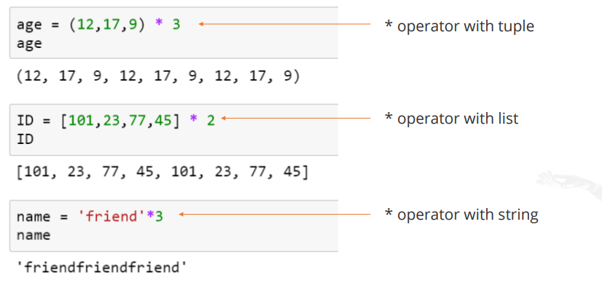
Basic Operator: *
The multiplication operator produces a new tuple, list, or string that repeats the original content.

Slide 25
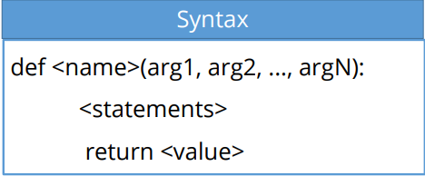
FUNCTIONS
Functions are the primary and most important method of code organization and reuse in Python.
Outcome of the function is communicated by return statement
Arguments in parenthesis are basically assignments

Slide 26
Functions: Considerations
Some important points to consider while defining functions:
A function should always have a return value.
If return is not defined, then it returns None.
Function overloading is not permitted.

Slide 27
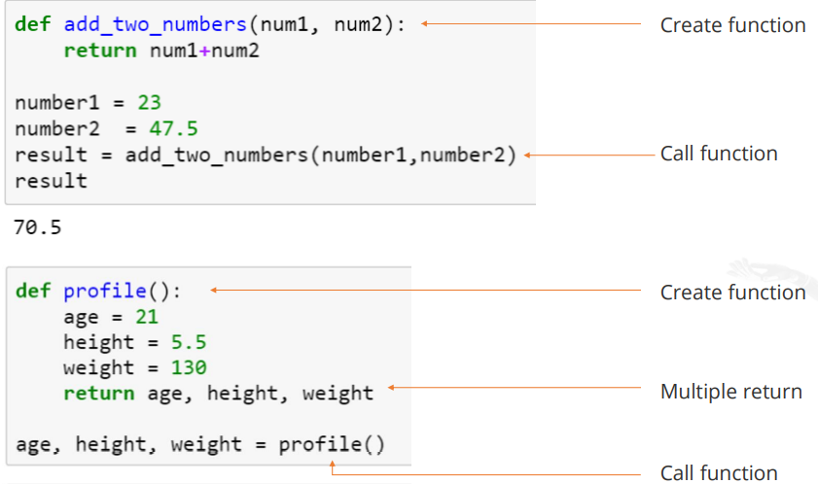
Functions: Returning Values
You can use a function to return a single value or multiple values

Slide 28
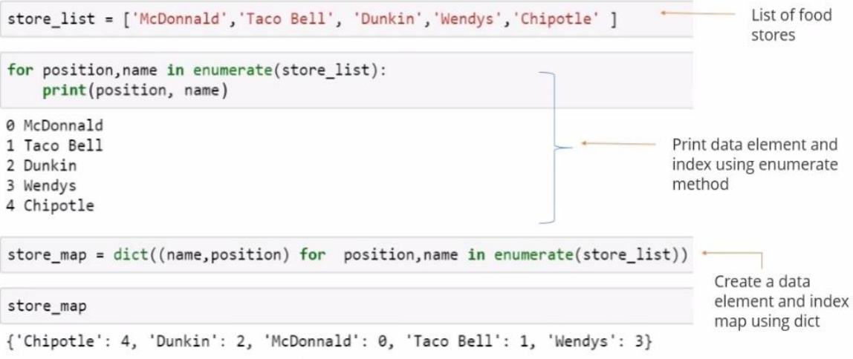
Built-in Sequence Functions: enumerate

Slide 29
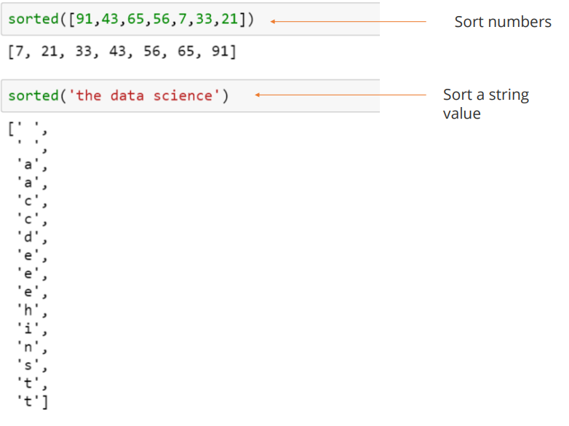
Built-in Sequence Functions: sorted

Slide 30
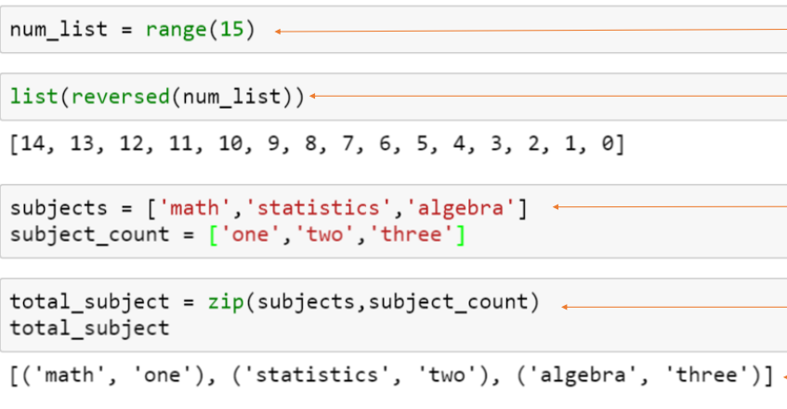
Built-in Sequence Functions: reversed and zip

Slide 31
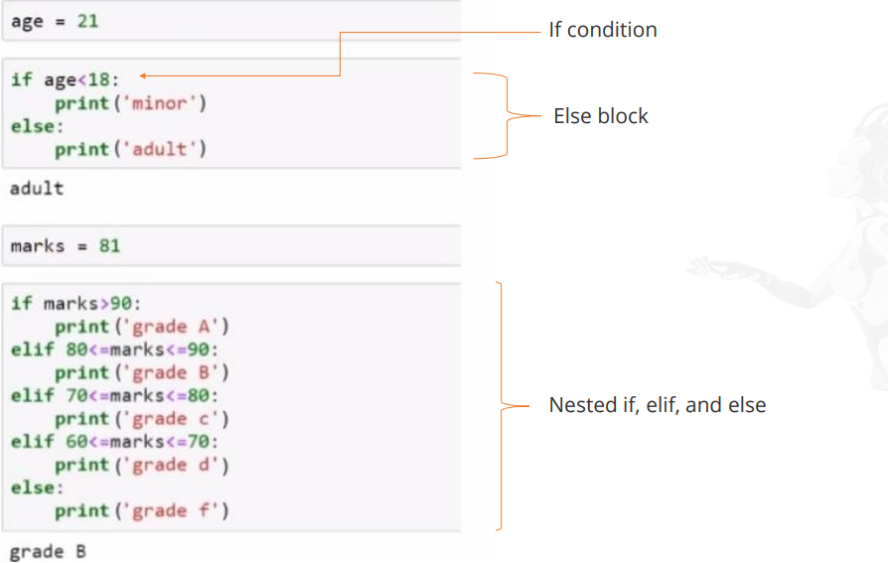
Control Flow Statements: if, elif, else

Slide 32
Control Flow Statements : for Loops
A for loop is used to iterate over a collection (like a list or tuple) or an iterator.
A for loop statement can be accompanied by a break or continue statement

Slide 33
